Slide 1


Minnesota FFA
TOWN HALL - SEPTEMBER

Slide 2
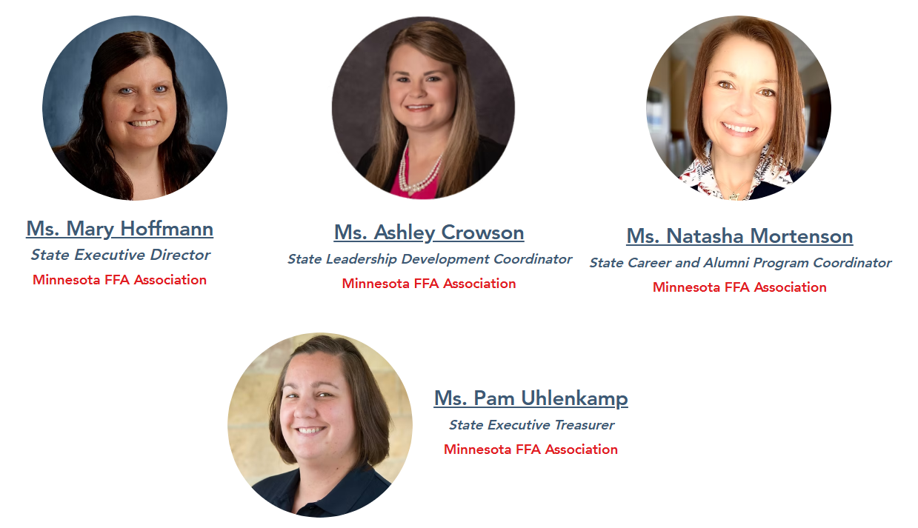
FFA STAFF

Slide 3
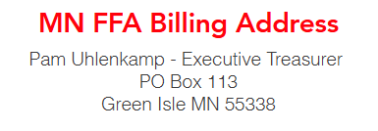
GETTING THE INFO
Make sure to:
  READ THE WEEKLY BLAST (COMES OUT ON TUESDAYS)
  MAKE SURE YOUR BUSINESS OFFICE HAS THE CORRECT BILLING ADDRESS FOR FFA
  ASK QUESTIONS WHEN YOU NEED HELP!

Slide 4

MEMBERSHIP/AFFIATION
Affiation is a CHOICE!
The National FFA Delegates did not pass mandatory Affiliation for all.
You don’t have to do Affiliation, but it is a great opportunity to embrace the 3 circle model!

Slide 5
FFA MEMBERSHIP
Active Membership - To be eligible for active membership in a chartered FFA chapter, a student must be enrolled in a secondary agricultural education program. In MN, this is 7-12 only!
    Please DO NOT put anyone younger than 7th grade on your roster, even if you are Affiliate!
    Online/PSOE Classes: *Can "x" Ag course online/college work for FFA membership? The answer is no, unless it's the local Ag Instructor who is the FFA Advisor that is teaching the class.
  The person teaching the class is the factor that determines where a student's FFA membership can exist, if it can exist at all. The local Ag. Teacher is the FFA Advisor.
  Overall Note: The student must take a class with you!

Slide 6
FFA MEMBERSHIP
Submitting Membership: Starts in AET!
  All of your students have a profile in AET (needs to be at 100% to push through to ffa.org)
  All students need to be in an Ag Class to be in FFA and classes are selected in AET.Make sure you only send 7-12 grade students you want to be members (send checkmarked).
  After your roster is pushed to ffa.org, you will need to go in to ffa.org and submit the students to State.
TUTORIALS/VIDEOS are at this web address:
    https://www.mnffa.org/aet-resources

Slide 7
FFA MEMBERSHIP
MN FFA will send you your Invoice!
  Do not pay AET
  Also, your AET subscription is paid for by MN FFA!
  If you want to add a donation to the MN FFA Foundation, email Mary Hoffmann with the amount and it will be added to your Invoice!

Slide 8
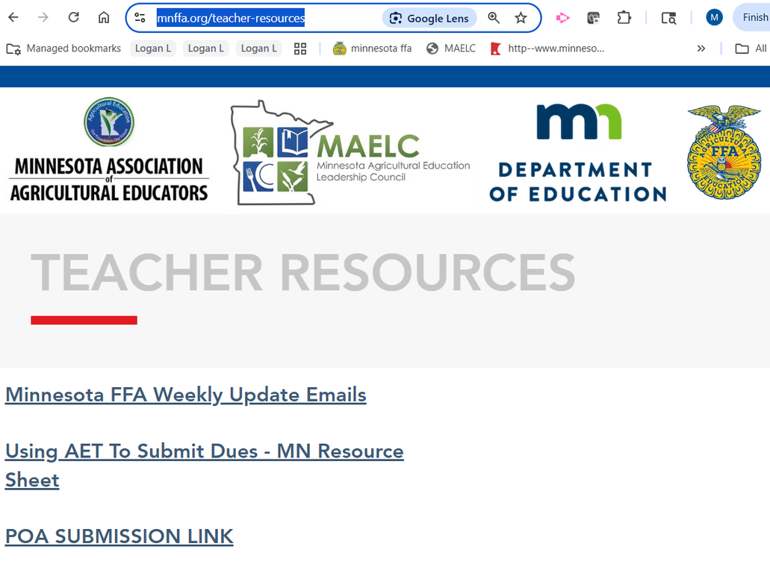
SUBMITTING YOUR POA
Each Year you need to submit your chapter’s POA!
  You can submit any type of POA, but Form 1 in the National Chapter Application would be a way to complete 2 things at once (POA and Superior Chapter
  Application)
TUTORIALS/VIDEOS are at this web
address:
  https://www.mnffa.org/aet-resources
Submission Link will be sent in the blast, but
also can be found here -
  https://www.mnffa.org/teacher-resources

Slide 9
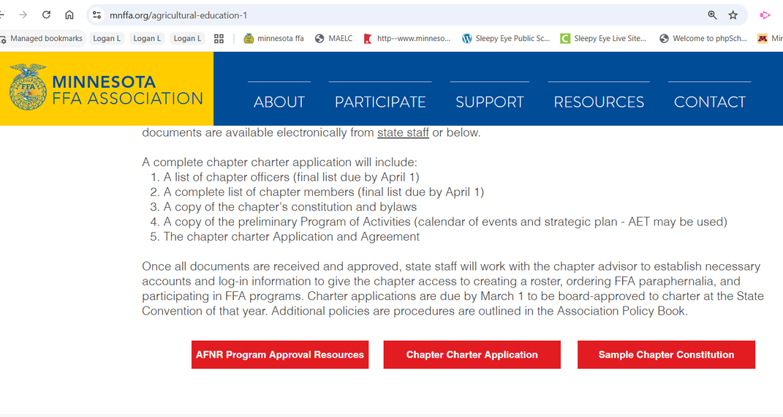
CHAPTER CONSTITUTION
Every Three Years you need to submit your chapter’s Constitution & Bylaws!
  Sample Constitution found here -
    https://www.mnffa.org/agricultural-education-1
TUTORIALS/VIDEOS are at this web
address:
  https://www.mnffa.org/aet-resources
Submission Link will be sent in the blast, but
also can be found here -
https://www.mnffa.org/teacher-resources

Slide 10
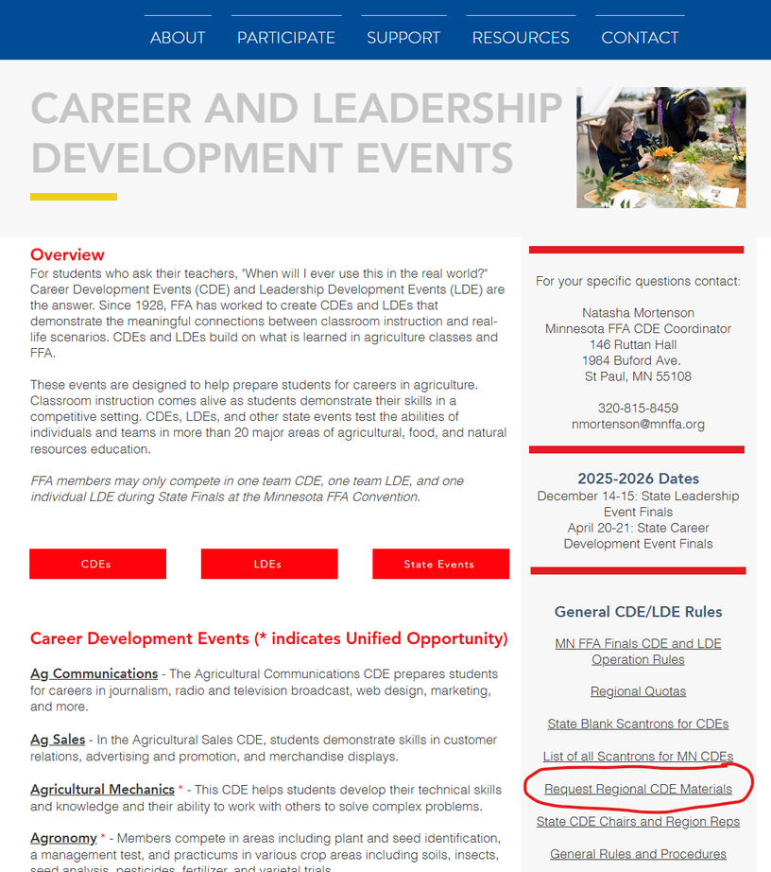
REGIONAL CDE MATERIALS
If you are a Regional Chair for a contest, request the materials on the MN FFA Website CDE Page!
  Complete the request at least a week prior.
  You will receive a calendar invite for the day you will receive the materials
  Once received, you can make copies.
  You must collect and destroy all copies and hide JMC scores.

Slide 11
NATIONAL CONVENTION
Any Questions?

Slide 12
WE ARE HERE FOR YOU!
Reach out to any of the FFA Staff for help! We want you to be successful!
Mary Hoffmann will be your number one contact for:
  Listserv, Membership, Website, Operations, Awards & Degrees, AET, and SAE’s
  mhoffmann@mnffa.org (507-766-0905)

Slide 13
WE ARE HERE FOR YOU!
Natasha Mortenson- nmortenson@mnffa.org (320-815-8459) CDEs, LDEs, Science Fair, Alumni
Ashley Crowson- on maternity leave!
QUESTIONS?

